Slide 1

Mayo clinic - phase 3
Presented By: Daryl Coston, Olamikun Asorona, and Devin Young

Slide 2
About Mayo Clinic
Mayo Clinic is the "largest integrated, not-for-profit medical group practice in the world" (About Us, n.d.).
Top-ranked in more specialties than any other hospital and has been recognized as an Honor Roll member according to U.S. News & World Report's 2024-2025 "Best Hospitals" rankings (Top-ranked Hospital in the U.S. - About Us - Mayo Clinic, n.d.)
Performs "basic, translational, clinical and epidemiological research at its campuses" (About Mayo Clinic Research, 2024)

Slide 3
Mayo Clinic Locations & Network Type Introduction
There are 4 buildings located in Arizona (Pheonix & Scottsdale), 9 buildings located in Florida (Jacksonville), more than 30 buildings located in Minnesota (Rochester), including the headquarters, and one building located in London, United Kingdom (U.S. And International Locations, n.d.)
With Mayo Clinic being geographically spread out, having approximately 65, 000 employees and approximately caring for more than one million people per year (Mayo Clinic Proceedings, 2024), it is considered a wide area network

Slide 4
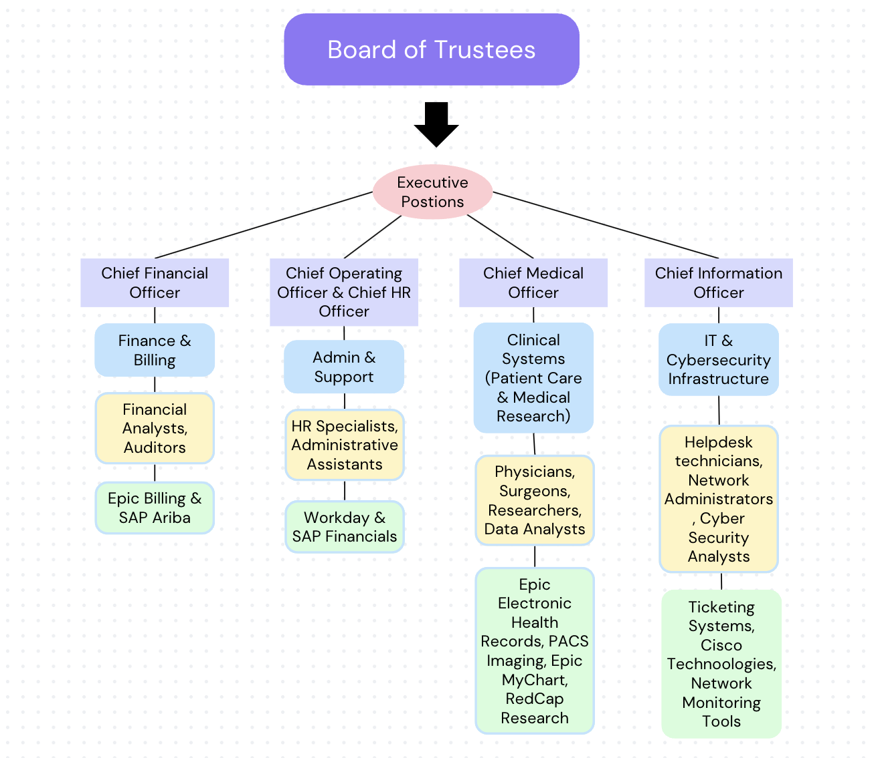
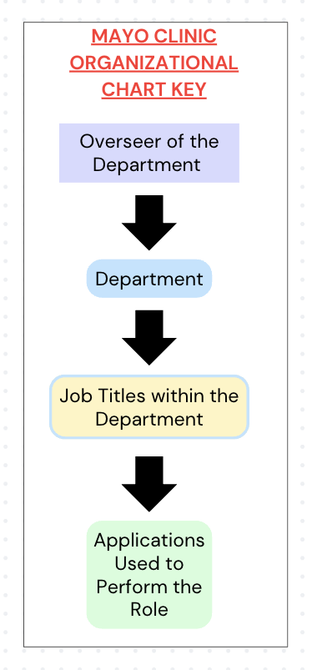
Mayo Clinic's Organizational Chart

Slide 5
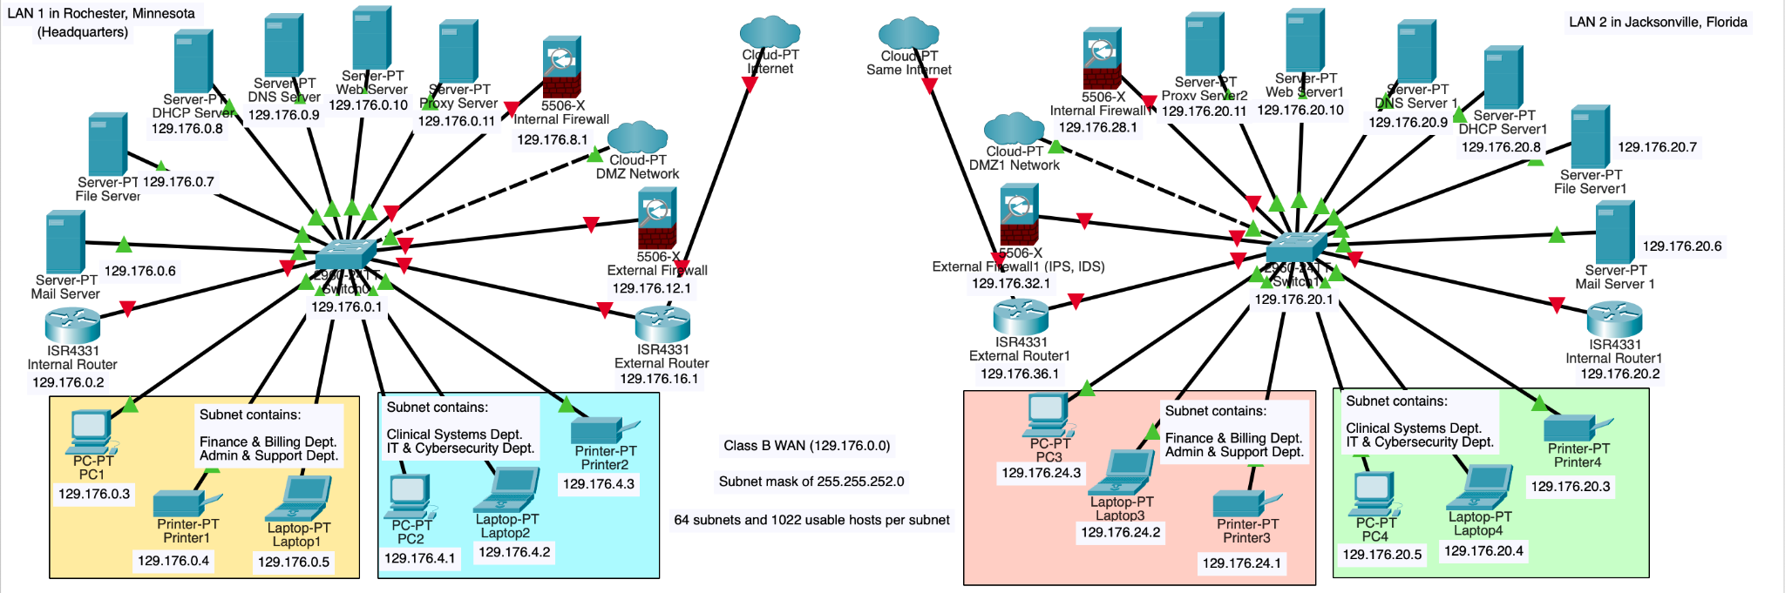
Mayo Clinic's Network Diagram

Slide 6
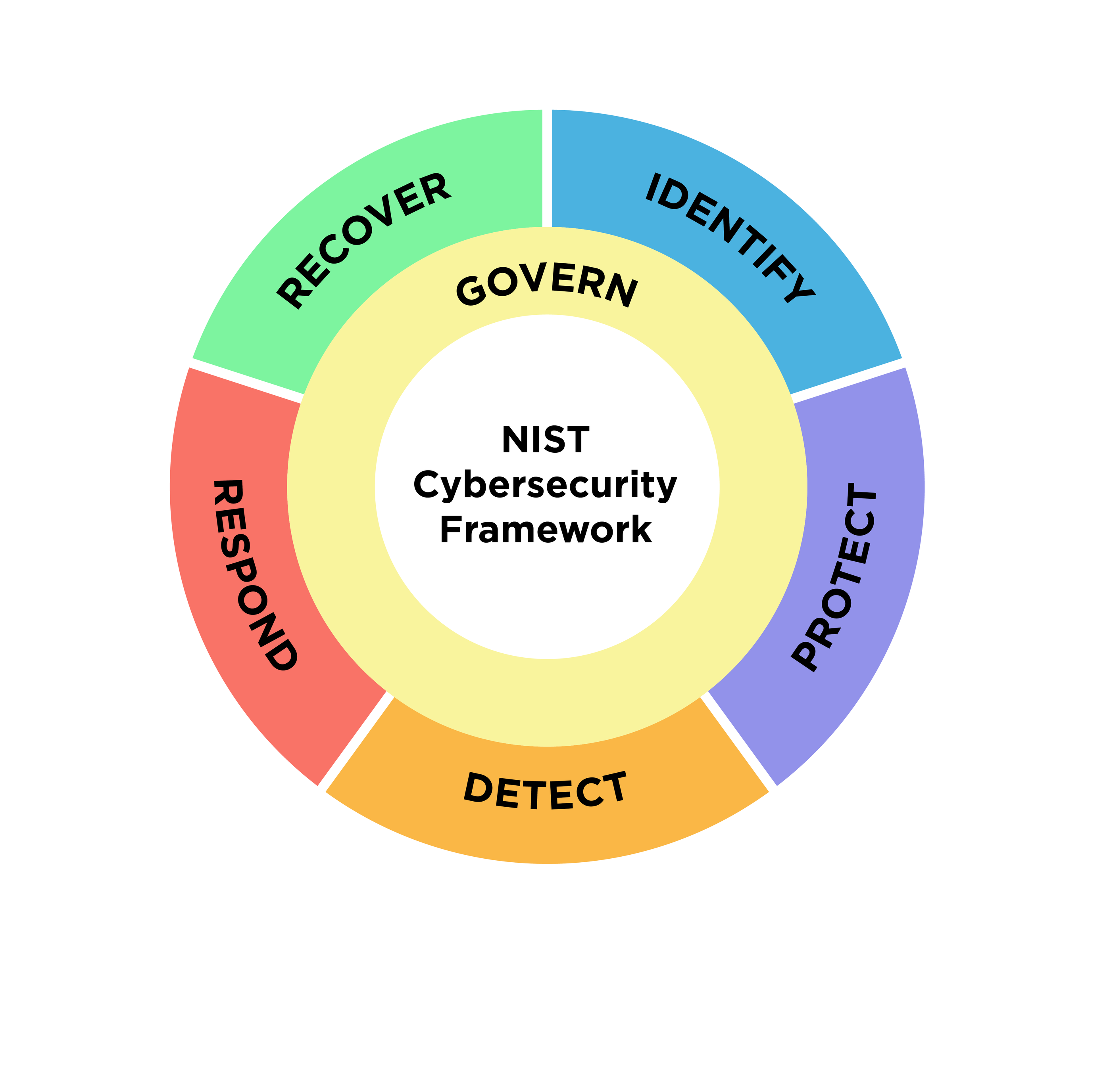
Core Functions of NIST Cybersecurity Framework
The NIST Cybersecurity Framework is centered around governing/managing cybersecurity practices, identifying cybersecurity risks and areas of improvements, protecting all assets, detecting cybersecurity attacks, responding to cybersecurity incidents, and recovering from cybersecurity incidents
(Shriram Vasudevan, 2022)

Slide 7
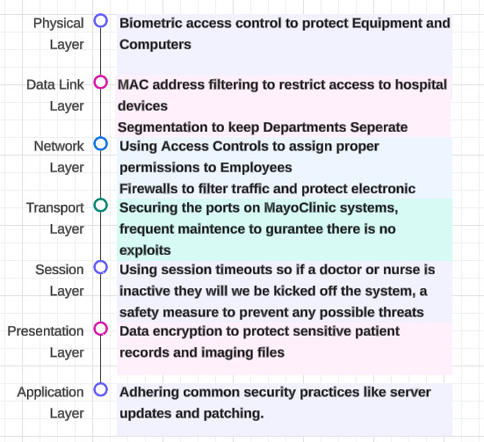
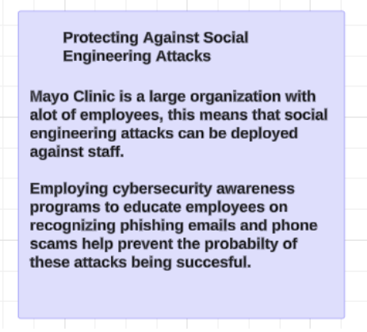
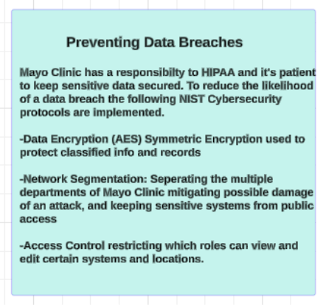
Initial Protections of Mayo Clinic's Enterprise Infrastructure

Slide 8
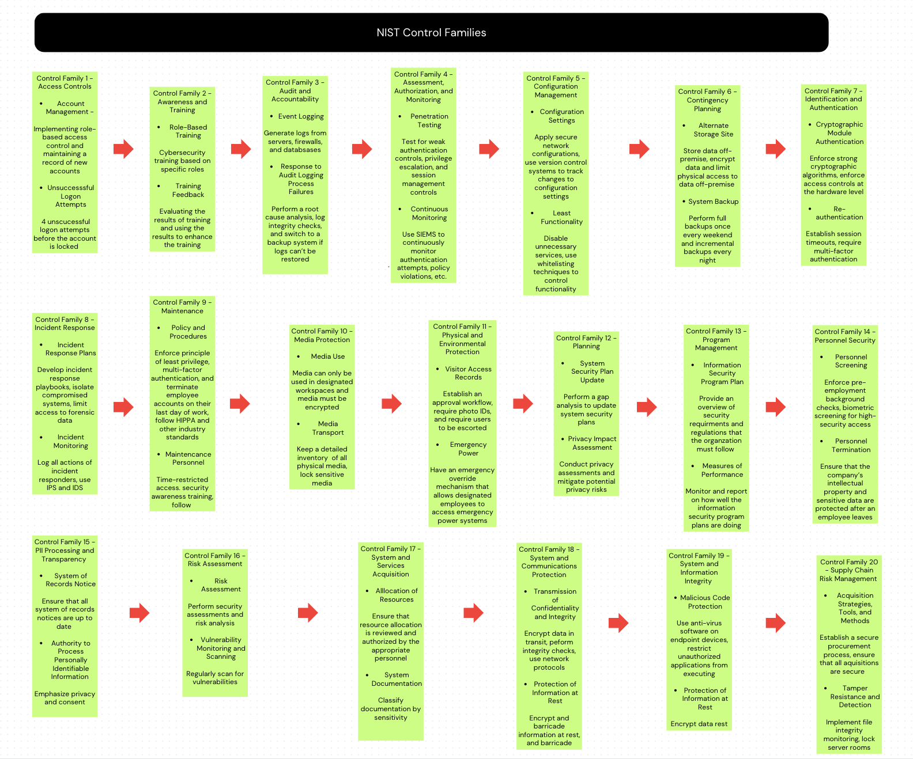
NIST Control Family Implementations

Slide 9
References
About Mayo Clinic. Mayo Clinic Proceedings. (n.d.).
https://www.mayoclinicproceedings.org/content/aboutmayo
About Mayo Clinic Research. (2024). Mayo Clinic. Retrieved October 31, 2024, from
https://www.mayo.edu/research/about/overview
About us. (n.d.). Mayo Clinic. https://www.mayoclinic.org/about-mayo-clinic
Health Insurance Portability and Accountability Act of 1996 | CMS. (n.d.).
https://www.cms.gov/about-cms/information-systems/privacy/health-insurance-portability-and-accountability-act-1996#:~:text=The%20Privacy%20Rule%20of%20the,and%20other%20personal%20health%20information.

Slide 10
References
NIST Cybersecurity Framework | NIST. (2024, September 27). NIST.
https://www.nist.gov/itl/smallbusinesscyber/nist-cybersecurity-framework-0
Shriram Vasudevan. (2022, April 14). OSI layer and corresponding cyber attacks and threats [Video]. YouTube.
https://www.youtube.com/watch?v=FqP4QiyKh4M
Top-ranked hospital in the U.S. - About Us - Mayo Clinic. (n.d.).
https://www.mayoclinic.org/about-mayo-clinic/quality/top-ranked
U.S. and International Locations. (n.d.). Mayo Clinic.
  https://www.mayoclinic.org/locations

